Slide 1



Steps to a Successful
European School Sports Day
2024

Slide 2
https://www.youtube.com/watch?v=5MugExwWiqw&t=16s

Slide 3
“The Joy of Sport and Physical Activity”
The European School Sport Day (ESSD) is a school day dedicated to having fun, playing together and promoting physical activity and health for everyone. It is a celebration which provides the opportunity for schools to:
Raise the profile of physical education (PE) and school sport
Create fun and enjoyment through physical activity initiatives for young people
Promote health and wellbeing for lifelong learning
Foster social inclusion and develop social competences among their students.
ESSD is open to any kind of physical activity that has the aim to encourage children to be active for at least 120 minutes per the day or to run or walk the distance of the given year (e.g. 2023 metres in 2023).

Slide 4
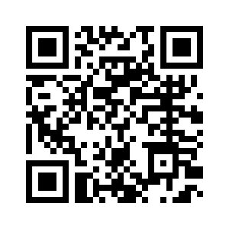
SATPE – European Sports Day 2023
6 Steps to Success
Plan
Step 1
Register (to enter the draw) https://www.satpe.co.uk/european-school-sports-day/
Step 2
Download resources (the 2022 toolkit is also available through SATPE and it’s really good! New ESSD game videos are available here too)
Step 3
Select how you are going to participate
Step
Save the date in your school planners/diary (29th September – if you can make this date plan an event in this week 25th -29th September)
Step 5
Choose how you are going to deliver e.g. Whole school or individual classes
Step 6
get others involved to help - sports committee, parents, secondary schools and primaries working together

Slide 5

Deliver
Step 1 – Know your content
Step 2 - Ready your equipment
Step 3 - Set your timetable but be flexible
Step 4 - Remember what it is about. It’s a celebration.
The European School Sport Day (ESSD) is a school day dedicated to having fun, playing together and promoting physical activity and health for everyone.

Slide 6
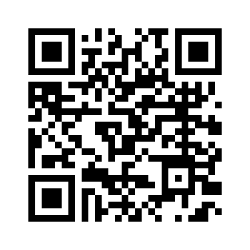

Celebrate
Download your School/Class Certificate https://www.satpe.co.uk/celebration-of-essd/
Twitter @SATPE @sportscotland @EdScotland
Please tag us in your Tweets! We would love to share in your success
Showbie
Seesaw
School Assembly
School newsletter/school social media channels

Slide 7

Prize
If you participate in ESSD you will automatically be entered into the SATPE ESSD draw.
The lucky schools to be drawn at random, will receive a sports gift from SATPE
1 prize for Primary
1 Prize for Secondary

